Slide 1
Unit objectives
After completing this unit, you should be able to:
Analyze the features of 2G/2.5G/3G/4G
Describe WLAN and 802.11 standards
Describe the features of all IP network and 4G netwoks
Explain the significance of OSS/BSS

Slide 2
What this unit is about
This unit covers the following topics
Evolution of Mobile communication covering 1G, 2G, 3G, and 4G
The above topic covers the features of various mobile standards such as speed, frequency spectrum used and multiple access technology used
WLAN and 802.11 standards
Various 802.11 standards are discussed used for specific applications
ALL IP and Mobile 4G networks
Specifications of all IP and how 4G network utilizes all IP concepts at BSS and core network level will be discussed here.
OSS and BSS
Role of OSS and BSS in Telecommunication applications are discussed in this topic

Slide 3
Course description
Purpose: To provide introduce audience towards standards
basic of Mobile communication and its
Audience: Students who have basics of Analog and Digital Communication
Perquisite: Fundamentals of Analog and Digital Communication
Course objectives:
Analyze the features of 2G/2.5G/3G/4G
Describe WLAN and 802.11 standards
Describe the features of all IP network and 4G netwoks
Explain the significance of OSS/BSS

Slide 4
Overview
Evolution of Mobile Wireless Communication System
First Generation Wireless Networks
Second Generation (2G) Wireless Cellular Networks
Major 2G standards and 2.5G Wireless Networks
Third Generation 3G Wireless
Wireless Local Area Networks (WLANs)
Cellular - WLAN Integration
All-IP Networks and 4G
IT Applications in Telecom Business
Overview of OSS/BSS Applications
Architecture and Framework
OSS Components
BSS Components

Slide 5
Evolution of Mobile Wireless Communication System
Mobile communication
protocol is one of the most required topic in the area of
telecommunication
Mobile communication statndards started getting evolved from the year 1980
The main objectives of mobile communication protocol are
to establish communication between two user any time and between any places
to maintain quality of link throughout the communication

Slide 6
Contd..
1G | 2G | 2.5 G | 3G | 4G
Analog cellular | Digital cellular | Digital cellular | Digital cellular | Digital Cellular
Voice | Voice /data | data | Vioce / high speed data | Voice over IP/high speed data
AMPS | CDMA | 1XRtt | CDMA2000 | -
TACS | GSM | GPRS | W_CDMA (UMTS) | LTE
80’ | 1992 | 1999 | 2001 2003 | 2005
AMPS: Advanced Mobile Phone System TACS: Total Access Communication System GPRS: General Packet Radio Services

Slide 7
First Generation Wireless Networks
I
Major Radio Standards in North America
AMPS-1983-824-894 MHz, FDMA, FM, 30 Khz Channel Bandwidth
Major Mobile Radio Standards in Europe
ETACS -1985 -900 MHz , FDMA, FM, 25KHZ Channel Bandwidth
NMT-450 1981- 450-470 MHz , FDMA, FM, 25KHZ Channel Bandwidth
Major Mobile Radio Standards in Japan
JTACS- 1988 A 860-925 MHz, FDMA, FM, 25 KHz Channel Bandwidth

Slide 8





Contd..
Disadvantages 1G
There is no common interface between the systems
It cannot quickly evolve to the digital system together with the fixed network, and it is hard to the provision the digital bearer service
Low frequency utilization rate, so it cannot meet the requirement for large capacity
Low security; the call can be easily eavesdropped, and the account can be easily embezzled

Slide 9
2G Wireless Cellular Networks
1. Cellular Standards Popular in North America
IS95- 1993 – 824-894 MHz , CDMA, QPSK/BPSK-1.25 MHz Channel
Bandwidth
. Cellular Standards in Europian Continent
GSM – 1990- 890-960 MHz, TDMA, GMSK, 200 KHz Channel Bandwidth
Cellular Standards in Japan
PDC -1993 - TDMA 810-1501 MHz II/4-DQPSK ,25K Channel Bandwidth

Slide 10
Contd..
Advantages of 2G
Effective spectrum utilization
Support large system capacity.
Variety of services such as voice, data, SMS, etc.
International roaming options.
Improved voice quality and good security features
Interconnection with ISDN and PSTN.

Slide 11
Contd..
2G Disadvantage
1. low-rate data services and donot support multi-media services. Ex: Internet speed of GSM is 9.6kbps
Some of the advancement technologies such as E-commerce and M-commerce are getting popular and demand a huge support from mobile communication which was not satisfied by 2G standards.
High demand for higher data through put because of varieties of application used by the subscriber.

Slide 12
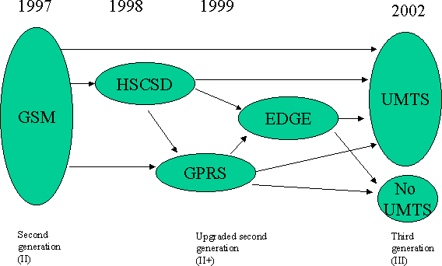
Contd..
2M
384K
171.2K
57.6K
9.6K
Frequency = 200 KHz
Fig.1 Evolution of GSM Data Service

Slide 13


Third Generation Wireless Evolution
I
3GPP R6
Frequency = 5 MHz
HSDPA=14Mbps
3GPP R5
2 Mbps
3GPP R4
Mbps
3GPP R99
2
Terminal point
2000/03
2001/03
2002/03
2006
Fig. 2 3GPP UMTS/WCDMA Development

Slide 14


Contd..
Frequency = 1.25MHz
3.1M bps
Support Data and Voice service at the same time
2.4M bps
Single carrier support Data service
1X-EV DV
307Kbps
Voice and Data
1X-EV DO
CS ANSI- 41
PS mobile IP
153.6K bps
1X Release A
1X Release 0
Timeframe
1999
2001
2001.10
2002.5
Fig. 3 Standardization of cdma2000--3GPP2

Slide 15
Wireless Local Area Networks
Wireless Local Area Network (WLAN)
Extension of a wired LAN
wireless access point helps in connecting device to the network.
Access point (AP)
Single point of contact for connecting devices to the network.
WLAN has a
interface called wireless network interface card (NIC) which consist of built in
antenna

Slide 16

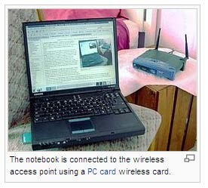
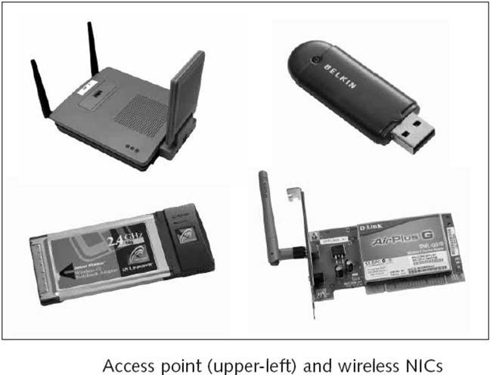
Contd..
M ICE (Innovation Centre for Education)
Figure : Courtesy Wikipedia
17

Slide 17


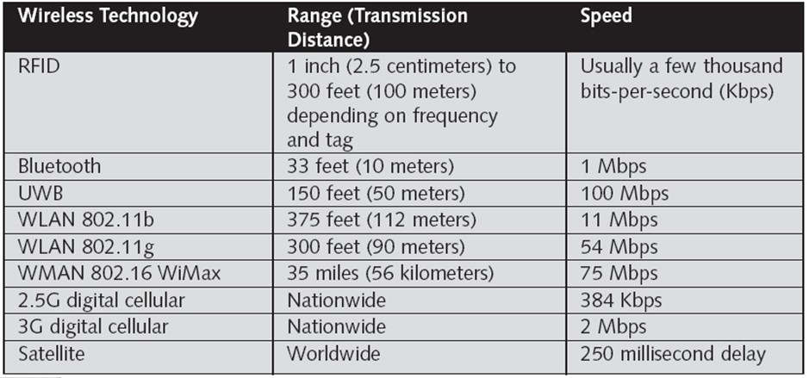











Contd..
Table 1.
Wireless Data Communication Technologies
Operating Frequency Band: 2.4 GHz Channel Bandwidh: 1 MHz
Power: 20 dbm ( 100 mW)
18

Slide 18
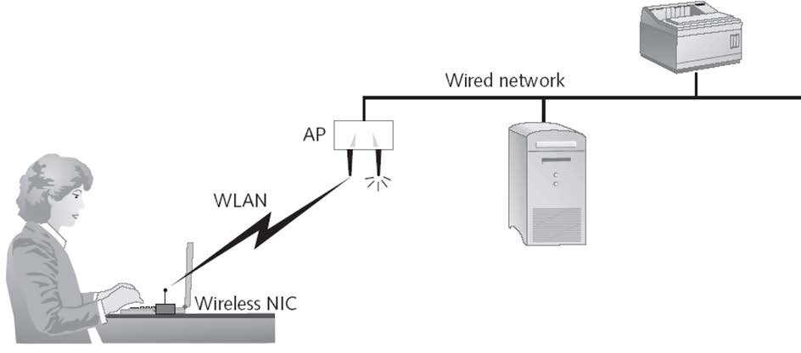

Contd..
Fig. 4 Office WLAN

Slide 19



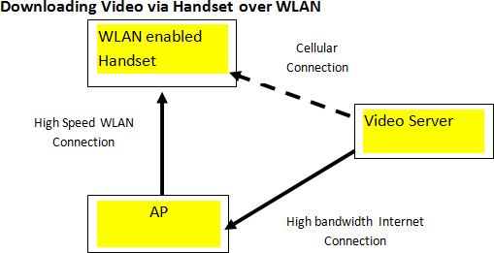

Cellular - WLAN Integration
Fig. 5 Integrating WLAN with Cellular Network

Slide 20


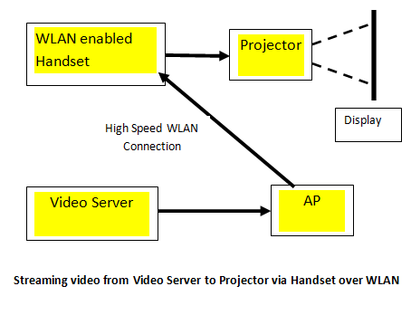
Contd..
IBM ICE (Innov
Fig. 6 Streaming video from Video Server to Projector via Handset over WLAN

Slide 21

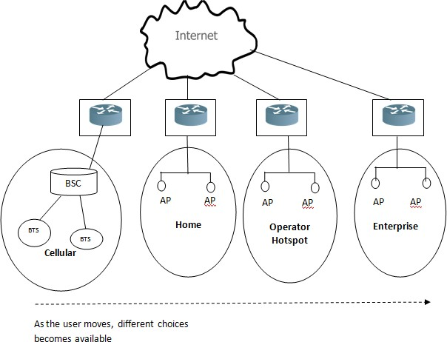

Contd..
“Fig. 7
Integrated Data Environment”

Slide 22
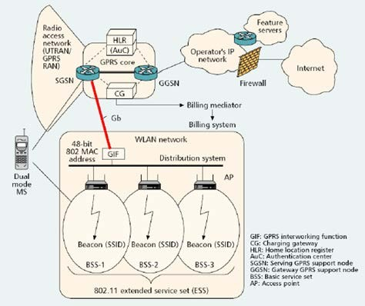




Contd..
Fig. 8 Tight Coupling –GPRS and WLAN
“Source: http://www.csie.ntpu.edu.tw”

Slide 23
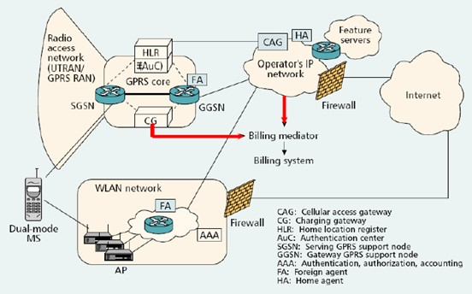




Contd..
Fig. 9 WLAN-GPRS Integration with Loose Coupling
“Source: http://www.csie.ntpu.edu.tw/~yschen/”

Slide 24
All-IP and 4G networks
All IP basically intended to provide IP connectivity between different entities of Mobile network. For example connectivity between BSC and MSC, BSC and SGSN, MSC and HLR etc.
All IP also intended to provide data transfer in cellular and WLAN using IP standards.

Slide 25
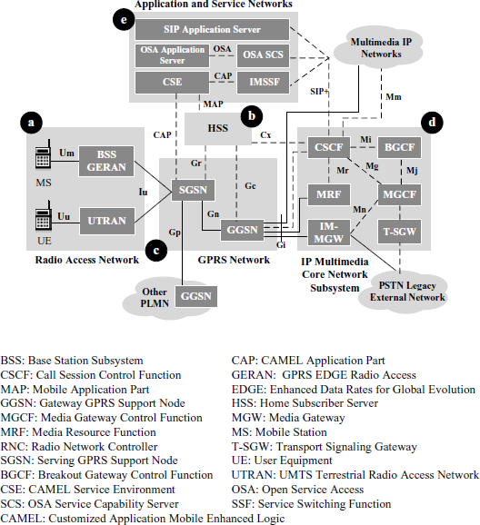




Contd..
Fig. 10 “The UMTS all IP architecture”
“Source: “Yi Bing Lin, Ai –Chun Pang “Wireless and Mobile all IP Networks,” WILEY

Slide 26
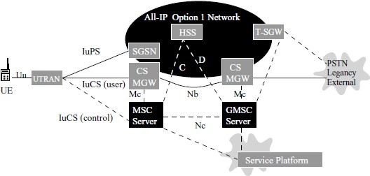



Contd..
Fig.11 all IP Network architecture
Source: “Yi Bing Lin, Ai –Chun Pang “Wireless and Mobile all IP Networks,” WILEY Publishers”

Slide 27
IT Applications in Telecom Business
Smart Meter
Infrastructure Management using IoT
Digital VAS (Value Added Services)
Outage Management Systems
Unified User Profiling
Business Intelligence (BI)

Slide 28
Introduction to OSS/BSS
Operational Support System (OSS) performs management, engineering, inventory,
planning, and repair functions for telecom operators.
BSS used in handling customers
processing and for payment options.
for managing
customer
related
data,
bill
often abbreviated as OSS/BSS.

Slide 29
Overview of OSS/BSS Applications
OSSs and BSSs are essential for the smooth running of service networks and business
operations.
OSSs and BSSs are the base on which a telecommunications company builds its business;
they facilitate the management of networks operations and customer relations respectively.
They are also essential elements of a Service Delivery Environment (SDE), through which
service providers deliver enhanced IPTV, WEB, IMS, or a combination of services to large numbers of customers.

Slide 30
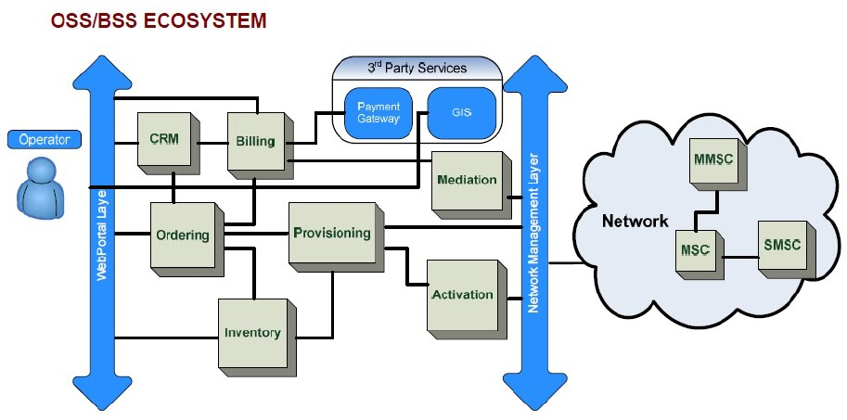

Contd..
Fig. 12 Interaction between OSS and BSS
Source: Advanced Concepts of Telecommunication Business (T102SG01), IBM Manual

Slide 31
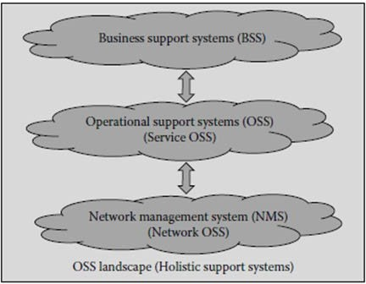




Contd..
Fig. 13 The OSS landscape
Source: Jithesh Sathyan“ Fundamentals of EMS,NMS, and OSS/BSS” CRC Press

Slide 32
Few OSS/BSS Processes
Provisioning
“Order management”
“Trouble ticket management”
“Inventory management”
“Billing”

Slide 33
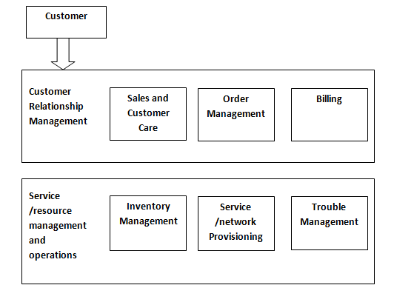

Contd..
Fig. 14
Mapping of Support system Process

Slide 34
The OSS Architectural Framework
With transformations in the telecommunications industry, it became imperative to have
enterprise architectures with integrated OSS and BSS applications.
However, there have been certain roadblocks – such as OSS/ BSS systems unique to
operators, lack of standardization to be able to develop applications to integrate the systems, and difficulties in sourcing software without the hassles of integration
These problems were overcome when the TMF came into existence. With The TMF
standards and business models, operators could purchase diverse OSS and BSS applications from various independent software vendors and easily integrate them.

Slide 35
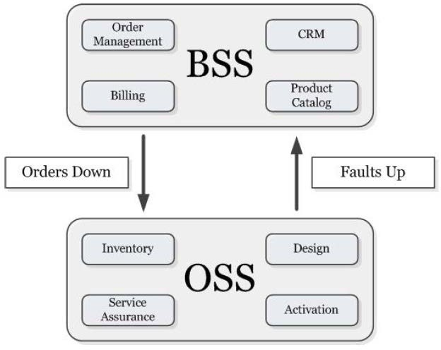
Contd..
Fig. 15 Interoperation of BSS and OSS ( Source: www.ossline.com)

Slide 36
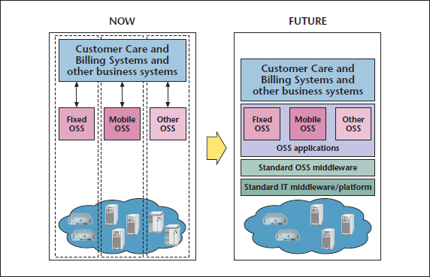




Contd..
Fig. 16 Evolution from vertical silos to platform architecture
“(Source: “White Paper on OSS/BSS reference architecture and its implementation
scenario for fulfilment)””

Slide 37
Components of OSS
Inventory Management
Network Inventory Management
Service Inventory Management
Resource Inventory Management
Order Management (OSS Aspect)
Provisioning and Activation
Service
Assurance

Slide 38
Inventory Management
Inventory, in the context of a communication service provider (CSP), is defined as equipment and facilities available on the networks.
The CSPs store information about the inventory on their networks on a system called the Inventory.
Inventory management is done via an OSS that keeps a record of network assets, both physical and logical.
The OSS also keeps a record of the assets assigned to customers.
Inventory management has two functions – inventory creation, and provisioning of services to customers.

Slide 39
Network Inventory Management
Network Inventory Management (NIM) software helps administrators maintain updated records about the number of devices on the network, and their type and status.
The software has features encompassing network discovery and network configuration management. NIM tools enable administrators to manage a number of networked devices at the same time from a remote location and also to schedule routine tasks.
The software automatically synchronizes the inventory database and the network, generates reports, and leads to the resolution of inventory inconsistencies to maintain complete operational integrity.

Slide 40
Service Inventory Management
The service inventory management application records the instances and
attributes of the customer facing services also called CFS, resource facing services also called RFS, and service relationships.
The system can map the CFSs and RFSs to service components or other
services.

Slide 41
Resource Inventory Management
Resource Inventory Management applications store information about resource utilization for the implementation of services and products.
The application is linked to the elements of the management systems and resource inventory database systems.
Some examples of Resource Management applications are Amdocs’ Cramer Resource Manager, Amdocs’ Cramer Sync Engine, and axPerience, axACS, and axDHCP from Axiros GmbH.

Slide 42
Order Management (OSS Aspect)
Currently available order management systems utilize scripts that enable flexible workflow
engines to integrate the manual and the system service tasks to achieve highly automated and intelligent operations.
The system carries out routine resource check tasks before the involvement of human effort
These systems can quickly adapt to changes in business requirements, as they can
automatically generate process scripts, test updates, and deploy them.

Slide 43
Service Assurance
The process of service assurance comprises the following:
Network and service testing
Service management
Problem management
Fault management
Trouble ticket management
Customer experience management
Performance management
Network traffic management
Service level agreement monitoring

Slide 44
BSS Components
Customer Relationship Management
The Billing Functionality
Mediation Systems
Order Management (BSS Aspect)

Slide 45
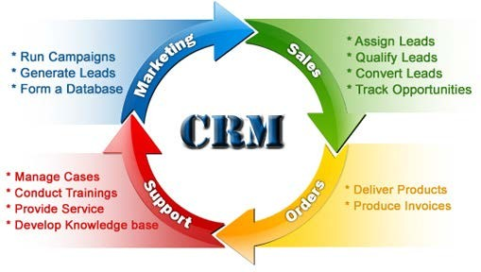

Customer Relationship Management
Fig.17 Functions of a CRM system
Source: Advanced Concepts of Telecommunication Business (T102SG01), IBM Manual

Slide 46
CRM Contd..
Telecommunications service providers need to have a continuous, unified analysis of their
customers (organisations and individuals) to be able to support their complex requirements, through customer-centric systems like Customer Relationship Management (CRM).
A CRM solution helps companies maximize
satisfaction, and thus increase revenues.
their
account
potential,
enhance
customer
CRM system consolidates and integrates customer data dispersed over multiple systems, and
streamlines processes.
This
enables service
providers
to take
on a customer-centric approach.
Also, customer
management comprises
customer services.
successful
partner
management and
round-the-clock web-based

Slide 47
The Billing Functionality
The billing functionality represents the focus of BSSs on charging, billing, and settlements
that deal with a OSS products and services.
For example, the revenue management is enabled to support order provisioning and partner
settlement functionalities of the OSS.
Billing is a set of processes encompassing the collection of customer usage data, calculation
of charges and billing information, production of invoices, processing of customer payments, and management of accounts payable and receivable.
Enterprise applications called Billing Systems manage the processes involved in billing.

Slide 48
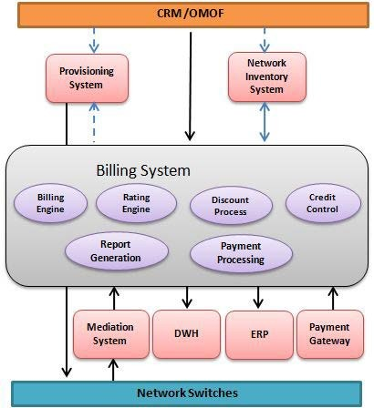

Contd..
Fig. 18 Billing System Architecture
“Source: Advanced Concepts of Telecommunication Business (T102SG01), IBM Manual”

Slide 49
Mediation Systems
Mediation systems improve marketing opportunities, enhance
operational excellence, and lead to financial risk management.
Telecommunications billing mediation is the main aspect of telecommunications mediation.
Companies including Comptel, Openet Telecommunications, Ace-Comm, Intec
Telecommunications Systems, Narus, and Amdocs make convergent mediation systems.

Slide 50
Order Management (BSS Aspect)
Order management is primarily an OSS component whose functions overlap BSSs.
An error-free orchestration of order management in the B/OSS leads to an improvement in
the productivity and accuracy of the overall process.
It minimizes the lead generation to cash generation cycle, and ensures that there are no
unbilled usages. The process of order management starts with a sales or a pre-sales activity, and ends with a fulfilled order.
In the process, a new or existing customer account is updated; information with regards to
billing, and problem and service handling, is stored.

Slide 51
Checkpoint
As discussed during meeting, add your questions here
1. Discuss the Evolution of Mobile Communication highlighting features such as throughput, frequency spectrum, Bandwidth, Modulation type used and Multiple access technology used.
2 . Explain various features of 802.11 standard
List the significance of Mobile IP
Discuss the interfaces where IP concepts are used in 4G technology.
Discuss the Telecom applications of OSS and BSS
© Copyright IBM Corporation 2016

Slide 52
Checkpoint solutions
As discussed, add your answers here
© Copyright IBM Corporation 2016

Slide 53
Unit summary
Having completed this unit, you should be able to:
Differentiate various Mobile communication Standards
List the features of WLAN and 802.11 standards
Highlight the Significance of IP Mobile Technology and its features
Understand how IP is used in 4G Technology
Compare BSS / OSS operations and its application in Telecom Industry
© Copyright IBM Corporation 2016

Slide 54


56

